Slide 1












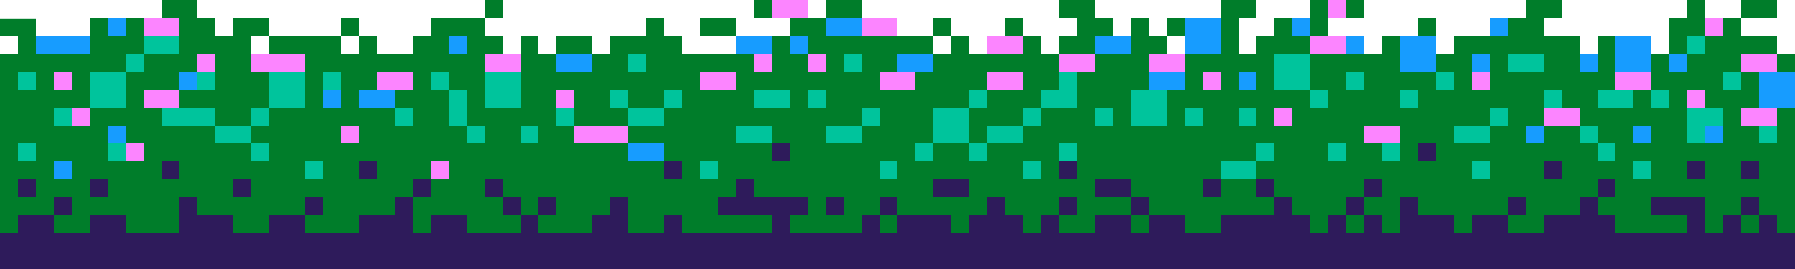
SPRINTSTUDY
BY : ALGORHYTHMS

Slide 2












ARE YOU READY ?
Thapelo Moloana
Katlego Tsotetsi
Siya
Nkosi

Slide 3



QUESTION:
WHY DO WE STUDY ?

Slide 4




TO MEET A DEADLINE
TO PASS
AN EXAM
Understanding
PRIDE
WISDOM
BUILD REALTIONSHIP

Slide 5







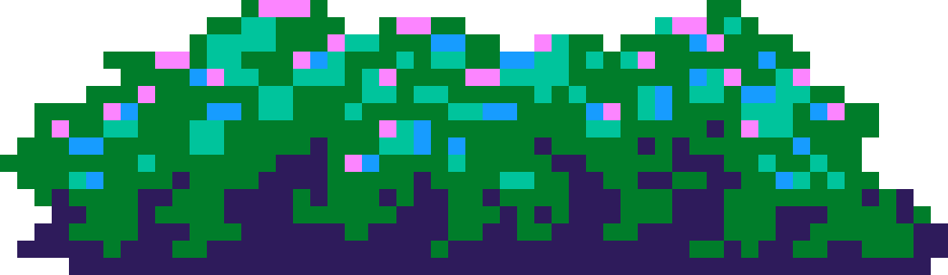
HOW DO WE HELP
STUDENTS STUDY EFFECTIVELY TO GAIN UNDERSTANDING?

Slide 6





MULTIPLAYER
Make it
Fun
I Need
One More
concept
I’m in
in the Lead !!!

Slide 7



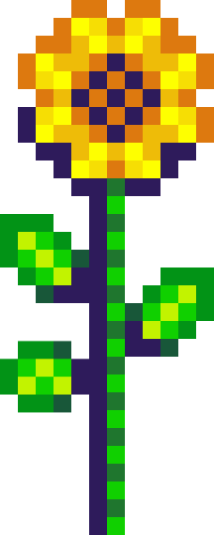

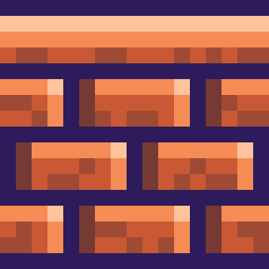
MAKE IT EASIER
QUIZZES
GAME ON
FLASH CARDS
SUMMARIES
FORMULA BANKS

Slide 8
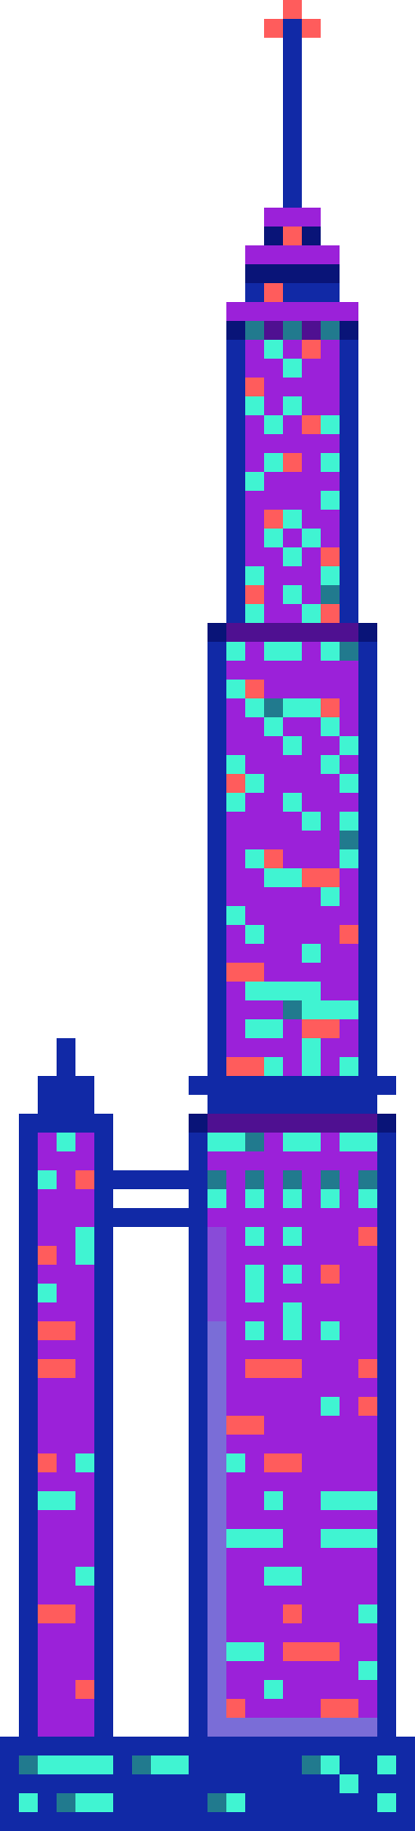







MAKE IT
SPRINSTUDY
Hello! Welcome to our new game.

Slide 9






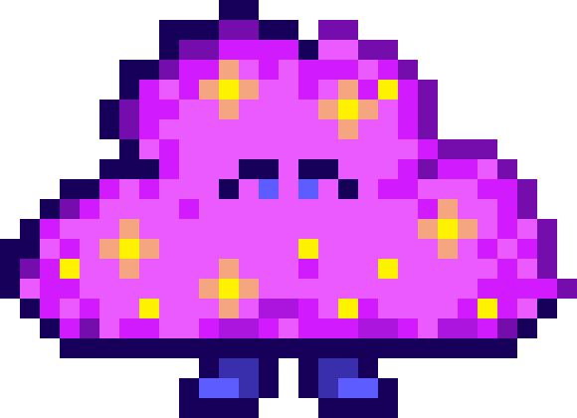

Our Project is a gamified study assistant for students where the student can upload their lecture notes and our system AI breaks them into summaries, flash cards, formulae banks and quizzes.It also turns studying into a race with friends, Earning XP and unlocking badges. You can also see when your friends are studying so you can join them or compete to finishes the stages first.

Slide 10



How it’s made
Okay Siya. We broke this into 3 assignments. Work on the frontend, backend and the gamification stage
Yeah, we built the App UI, then set up a system that extracts text from uploaded files, and then sends it to ChatGpt with structured prompts
So I see what you want to do. Let me ask this, how did you guys make this ?

Slide 11

That’s right, this wouldn’t be possible without me fellas.
Outside of chat, we have Leaderboards, badges, study races and XP.
Yeah Yeah Chat. Ai are so dramatic. So the Ai-generated study modules are saved into a database.

Slide 12
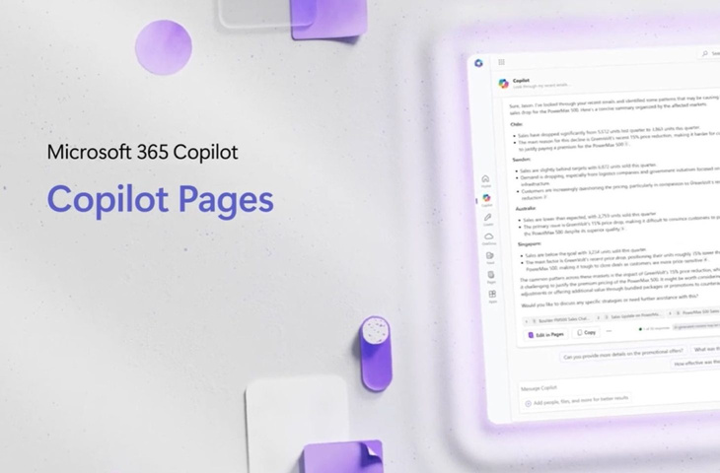

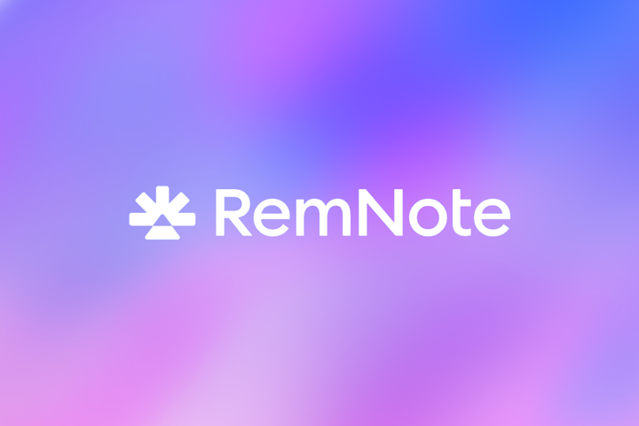
SIMILAR APPS
ORGANIZE
Apps similar to our App are your NotebookLM, Copilot Pages and Remnote. This similarity is in its ability to organize and structure content.
STRUCTURE

Slide 13

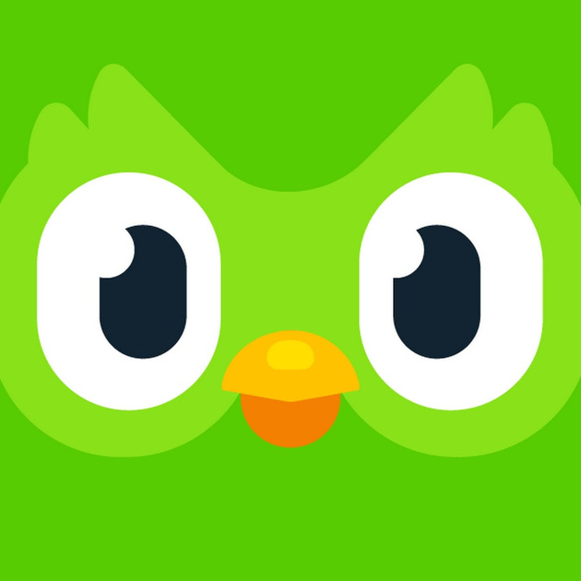

stand out Features
We Adopted Dulingo’s, make learning as “addictive” as social media, but developed an all purpose platfrom where we don't teach the content.

Slide 14



